Slide 1
Data Analysis Final Project: Disease Prediction
team – code blue
Frank Sullivan, jade bible, john setzer,
morgan behr, summer bell

Slide 2
Disease Prediction using Machine Learning
Reason Why the Topic was Selected
Developing a model where a list of symptoms can be input to make disease predictions can help diagnosing diseases faster
Description of the Data Source
The data used is two csv files downloaded from Kaggle.
The dataset utilized from a csv testing and csv training file.
The source of the data from the author is not disclosed.

Slide 3
Disease Prediction using Machine Learning
Questions We Hope to Answer with the Data
1. Can our machine learning model be used to predict the correct disease based on symptoms entered?
2. How many symptoms need to be present to increase the accuracy of the model?

Slide 4
Technologies and Languages
Python
Pandas
MatPlotLib
pgAdmin
PostgreSQL
Tableau
Notes:
To develop our disease prediction machine learning model required the use of multiple technologies and programming languages. We used Jupyter Notebook to write Python code for both data preprocessing and our machine learning model. A SQL database was created with pgAdmin. A Tableau storyboard was developed for interactive data visualizations. The following slides will provide detailed explanations of how each technology was used.

Slide 5
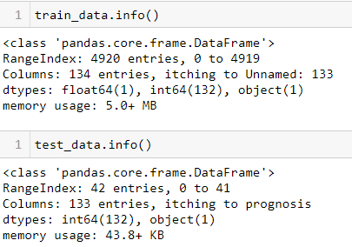
Data Exploration Phase
Preprocessing Data
Data Types evaluated
train_data.info()
test_data.info()
train_data.describe()
test_data.describe()
Null values removed
train_data.isnull().any()
train_data.drop(["Unnamed: 133"], axis=1, inplace=True)
Notes:
To begin the preprocessing the two CSV datasets were imported and assigned as to variables train_data and test_test. A key part of the data exploration phase is preprocessing the data. This allows us to learn about the data characteristics and identify potential problems. We used the pandas info and describe functions to explore the data. For the model to function correctly all data in both data sets has to be in the correct data type. We also needed to isolate columns with null data and drop that data. The isnull with any functions identified the null values then the drop function was used to remove it from the dataframe.

Slide 6
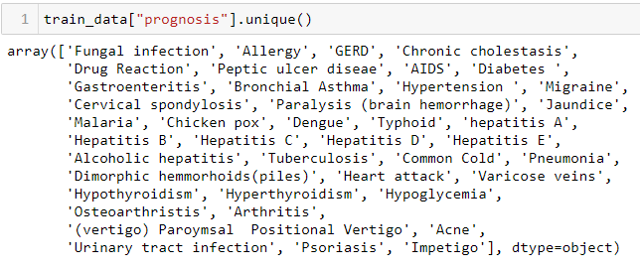
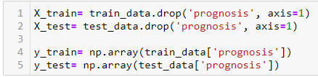
Training and Testing Data
Create Feature
Create Target
Notes:
Machine learning utilizes both training and testing data.
To prepare the data for the machine learning models we created our features and targets.
The unique() function is used to find the unique elements of an array. It returns the sorted unique elements of an array.

Slide 7
Create Symptoms DataFrame by Disease
Notes:
A list of symptoms for all diseases was created to allow for a GUI in our machine learning model where symptoms could be selected from a drop down box.

Slide 8
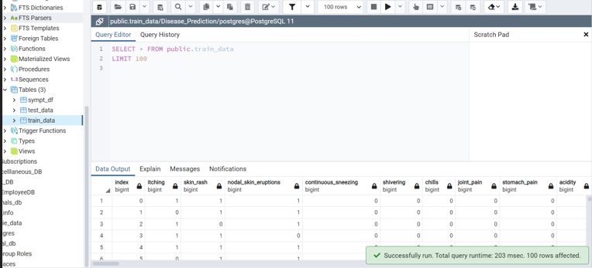
Database - pgAdmin
3 Tables:
Train_data
Test_data
Sypt_df
Notes:
The preprocessed train_data, test_data and sympt_df data sets were exported into PostgresSQL as three seperate tables.
This created a static database in pgAdmin for use during the project.
There is a detailed ERD the displays the relationships.
A join was performed on the tables.
The database interfaces with [Disease_Prediction_ML.ipynb](Disease_Prediction_ML.ipynb).
Using from sqlalchemy import create_engine the PostgresSQL data is used in our machine learning model.

Slide 9
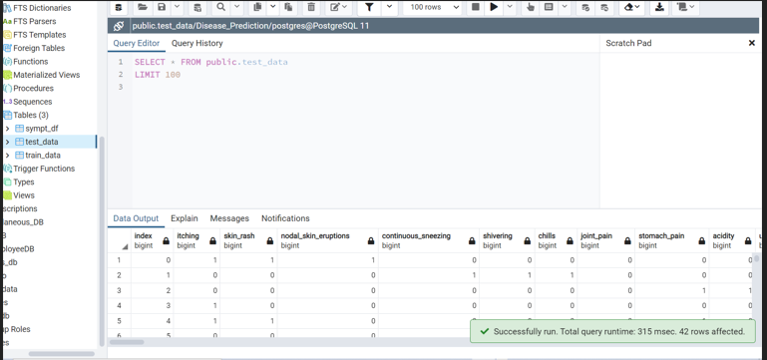
Database - pgAdmin

Slide 10
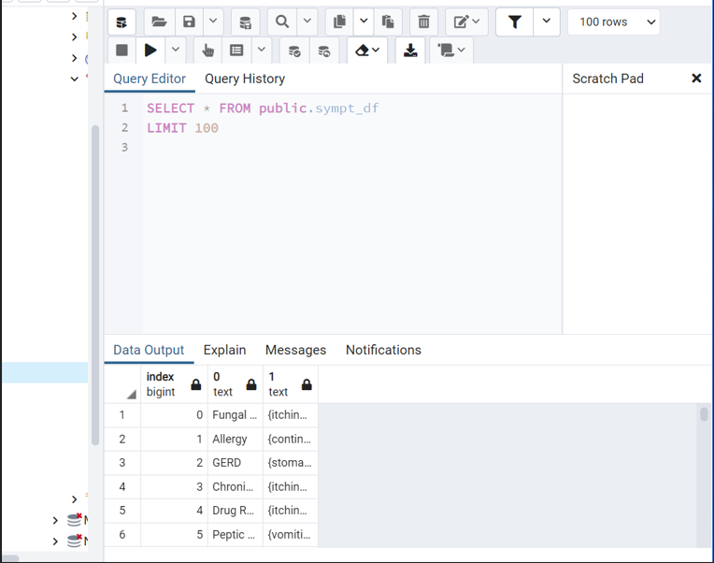
Database - pgAdmin

Slide 11
Data Analysis Phase
Choosing a model
Logistic Regression
Decision Tree
Random Forest
Naïve Bayes
Notes:
With a clean data set the data analysis phase can begin. There are many modeling techniques that can be used to analyze data. Our binary dataset is optimal for a logistical regression model because the prediction is categorical. A machine learning logistical regression algorithm can be used to predict the outcome of dependent variables based on previous training data.

Slide 12
Machine Learning

Slide 13
Dashboard
Interactive storyboard created in Tableau
Follow the link below:
Notes:
We have a fully functioning and interactive dashboard in Tableau. Our analysis will be displayed with a storyboard that provides clear data visualizations. Follow the link to see the charts and graphs that show insightful relationships in our data and images of our analysis.

